Slide 1
Experiment Number
To find the value of Planck's constant and photoelectric work function of the material of the cathode using a photoelectric cell.
Learning Objectives
To understand the working of a photo-electric cell.
To study the dependency of photoelectric current on incident light intensity and frequency.
To study variation of stopping potential with incident light frequency.
4. To find out the value of Plank’s constant.
5. To find out the value of value of work function of a given material.

Slide 2
The student will also be able
To visualize (virtually) the photoelectric effect and resultant photocurrent when the incident radiation wavelength is less than the threshold wavelength by using the change wavelength slide bar.
2. To understand the concept of stopping potential by changing the retarding potential using the slide bar in the virtual lab. The gradual decrease will be observable.
3. To understand the impact of intensity variation on the photocurrent value.
4. To perform the experiment by choosing different cathode material and understand the concept that different materials have different work functions.

Slide 3
Basic Understandings

Slide 4
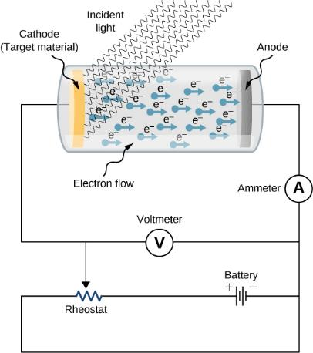
What is photoelectric effect?
When light of suitable frequency is incident onto a clean metal surface it will cause electrons to leave that surface (the light will eject the electrons from the surface). This is called photoelectric effect and the electrons are called photoelectrons.
Fig. An experimental setup to study the photoelectric effect. The anode and cathode are enclosed in an evacuated glass tube. The voltmeter measures the electric potential difference between the electrodes, and the ammeter measures the photocurrent. The incident radiation is monochromatic.
Materials: Alkali metals like lithium, sodium, potassium etc. are found to be very photo-sensitive. They emit electrons even when ordinary visible light falls on them. Experiments show that with light of suitable frequencies(ultraviolet rays, X-rays and ɣ-rays) almost all metals exhibit photoelectric effect.
@Dr. Subhojyoti Sinha
Ref: Concept of Modern Physics by Arthur Beiser

Slide 5
Experimental observations
(1) If the frequency of the incident radiation is greater than the threshold frequency (ʋ₀) (certain minimum frequency), only then the emission of electrons takes place.
(2) There is no time lag between illumination of the metal surface and the emission of electrons.
(3) The photoelectric current increases with the increasing intensity I of the incident radiation, if the frequency is kept constant. As shown in Fig. A.
(4) The maximum kinetic energy E_{K} of the photoelectrons is independent of the intensity I of the incident light. That is stopping potential is same for the light of different intensities having same frequency.
(5) The maximum kinetic energy of the photoelectrons depends on the frequency of the incident radiation. From Fig. B, we observe that at different frequencies, stopping potential is also different but the saturation current remains the same
A
B
@Dr. Subhojyoti Sinha
Ref: Engineering Physics : HK Malik and AK Singh

Slide 6
Einstein’s approach to explain the features of this effect
In Einstein’s approach, a beam of monochromatic light of frequency ʋ is made of photons.
A photon’s energy depends only on its frequency $ʋ$. Explicitly, the energy of a photon is E=h$ʋ. \text{where} \text{h} \text{is} \text{Planck}\text{’}\text{s} \text{constant}\text{. }$
Having this quantum understanding, the energy balance is
$hʋ$ =$φ{+KE}_{max}=$h$ʋ_{0}$ + $\frac{1}{2}mv_{max}^{2}=\text{h}ʋ_{0}+eV$
$or hʋ$ =$\text{h}ʋ_{0}+eV$ or $eV$= $hʋ$ -$\text{h}ʋ_{0}$
$or V=\left(\frac{h}{e}\right)$ $ʋ$- $\left(\frac{h}{e}\right)$ $ʋ_{0 }$. Compare it with y=mx + c
So, by plotting graph between $V$ and $ʋ$ and finding the slope we can find out the value of Plank’s constant. Work function $φ$ =$\text{h}ʋ_{0}$
where KEmax is the maximum kinetic energy, that an electron has at the very instant it gets detached from the surface. In this energy balance equation, $φ$ is the energy needed to detach a photoelectron from the surface. This energy $φ$ is called the work function of the metal. Each metal has its characteristic work function. $ʋ_{0}$ is the threshold frequency.
@Dr. Subhojyoti Sinha

Slide 7
Questions on
basic understandings

Slide 8
Check your understanding
Q
Q 2.1: The minimum frequency of the incident electromagnetic radiation that can cause the emission of photoelectrons with zero kinetic energy from the cathode surface and below which no emission occurs is called
Resonant frequency
Plasma frequency
Threshold frequency
Ultrasonic frequency

Slide 9
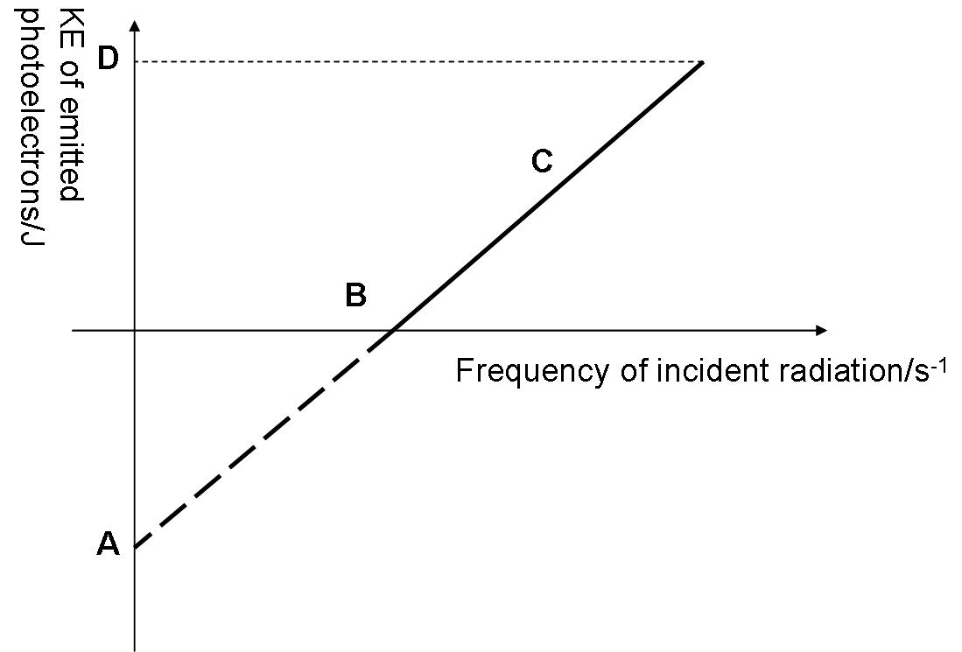
Check your understanding
Q
Q 2.2: In this graph the point A and B represent
work function and threshold frequency respectively
stopping potential and threshold frequency respectively
work function and kinetic energy respectively
threshold frequency and work function respectively

Slide 10
Check your understanding
Q
Q 2.3:In this graph it can be observed that photocurrent increases with increase in the value of the variable along x- axis. What is plotted along x axis?
Frequency of the incident light beam
Stopping potential
Intensity of the incident beam
Wavelength of the incident light beam

Slide 11
Check your understanding
Q
Q 2.4:Which of the following is true?
(A ) The work function of the metal A is more than the work function of the metal B
(B ) The work function of the metal B is more than the work function of the metal A
(C) The work function of the metal A is equal to the work function of the metal B
(D) None of the above

Slide 12
Check your understanding
Q
Q 2.5:Which of the following is the correct interpretation of the graph?
(A)For a frequency ʋ of incident radiation, lower than the cut-off frequency (ʋ ₀, ʋ ₀’) , no photoelectric emission is possible even if the intensity is large.
(B)The maximum kinetic energy of the photoelectrons varies linearly with the frequency of incident radiation,
(C) The maximum kinetic energy of the photoelectrons is independent of the frequency of incident radiation,
(D) Both option (A) and (B)

Slide 13
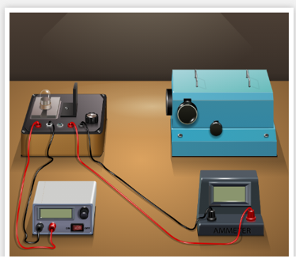
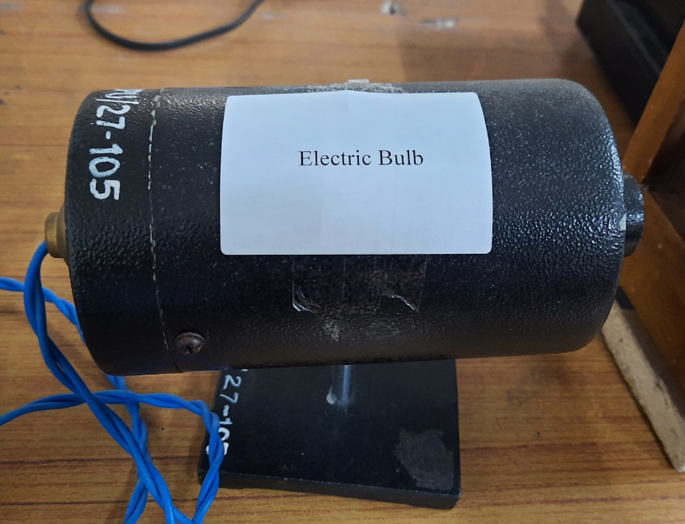
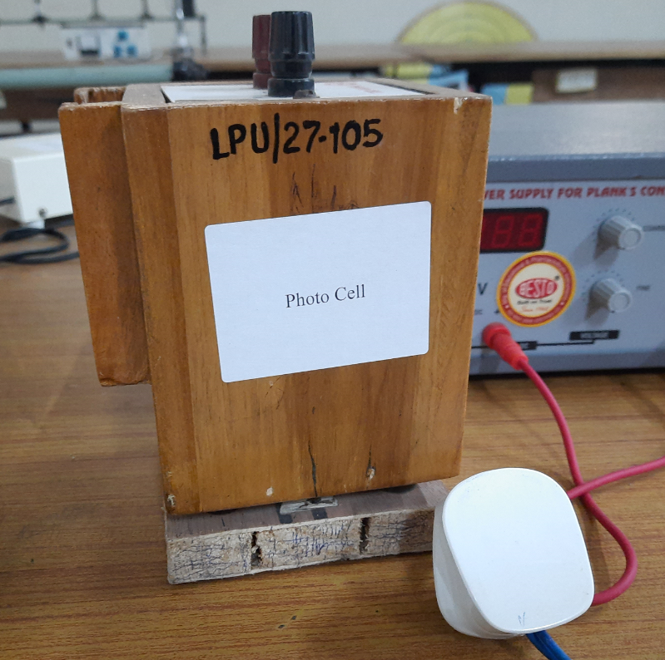
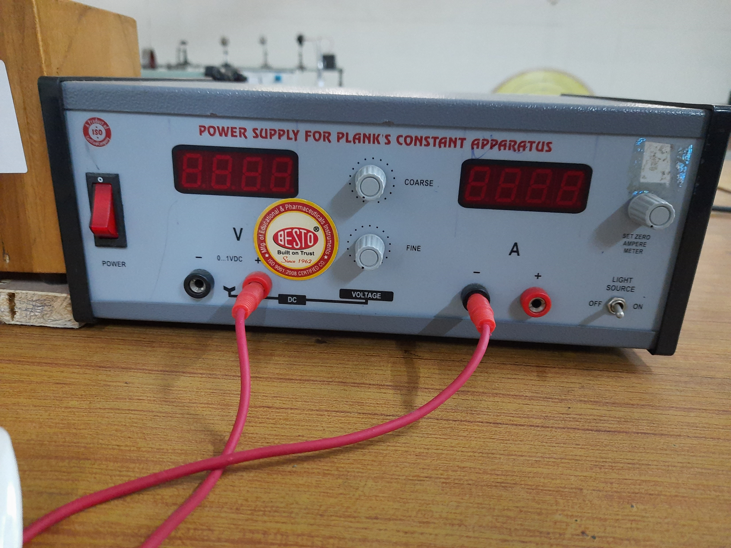
Apparatus required for the experiment
A photocell, Power supply, digital ammeter and voltmeter, Filters of different colors ( wavelength)

Slide 14
Step by Step guide to perform the experiment in Virtual lab

Slide 15

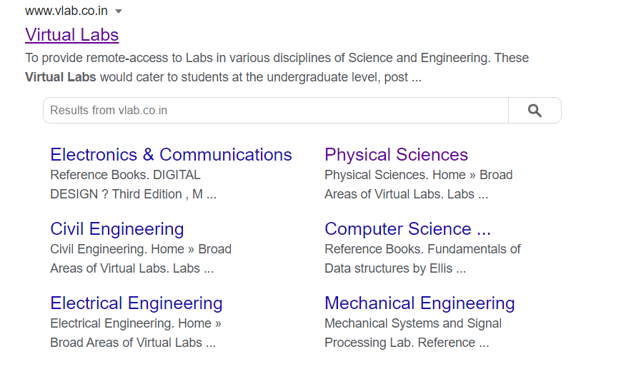
Type this link on the address bar or Click on this link : https://www.vlab.co.in/

Slide 16


This page will open. Scroll down the page end click on Physical sciences

Slide 17
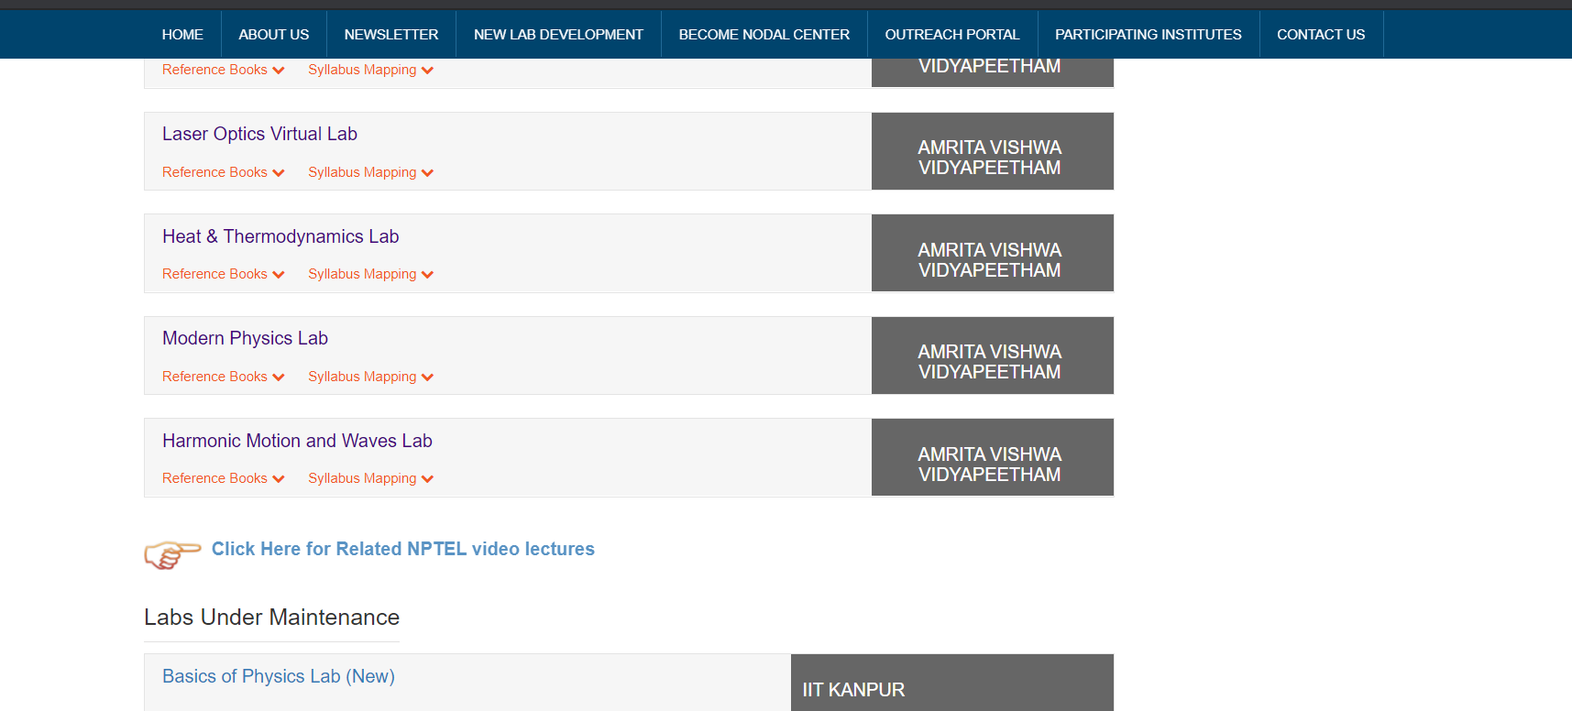
Scroll down the page end click on Modern Physics Lab

Slide 18
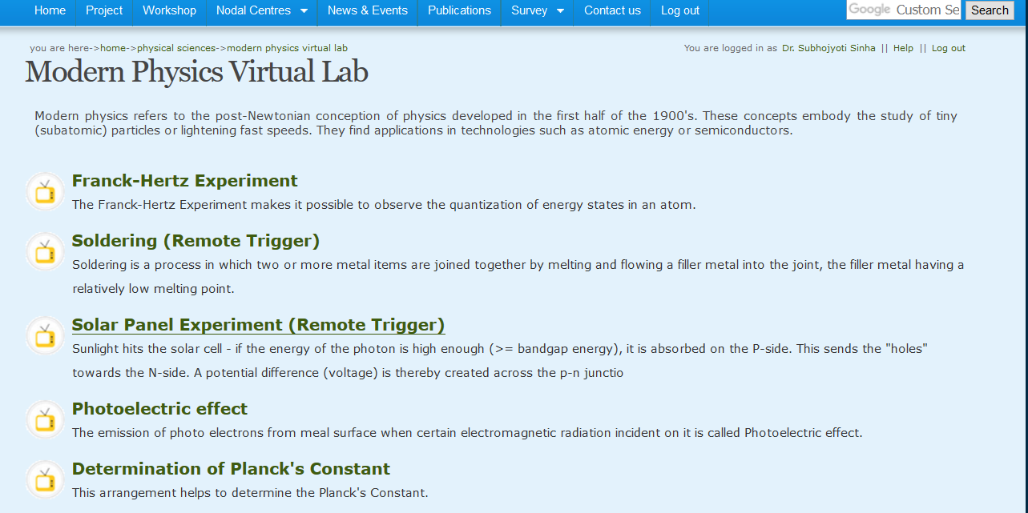
Click on Photoelectric Effect

Slide 19
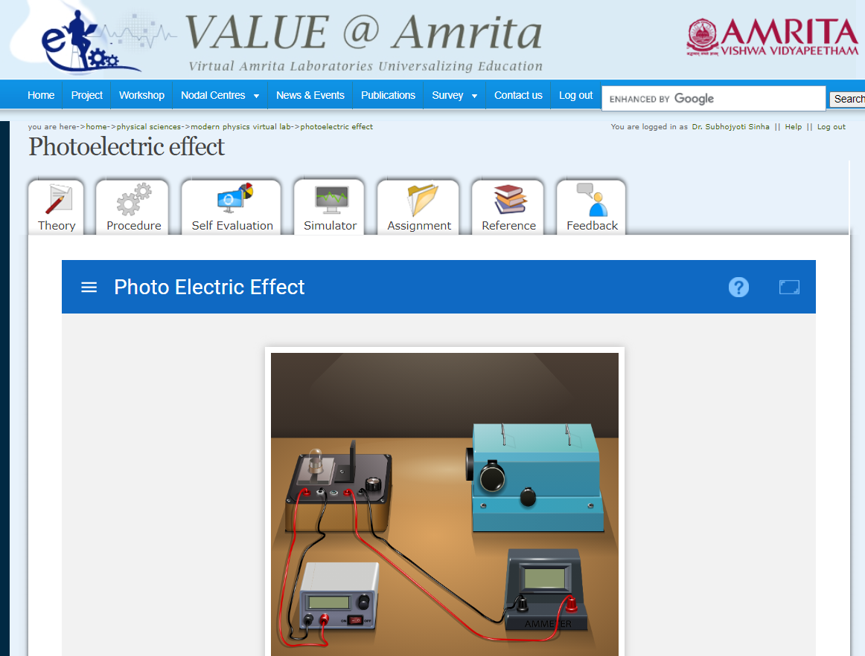
This page will open. You have to login and Click on simulator.
But it covers some portion of the oven and you have to toggle the show variables option while performing the experiment.
Alternatively you can click on the following link ( next page) for the same simulator

Slide 20
Click here to zoom

Slide 21
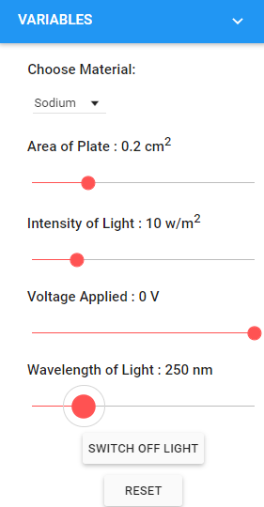
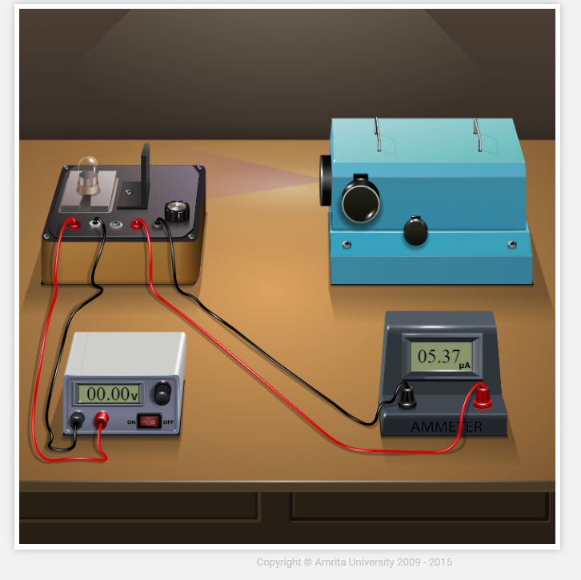
Choose the Material, Switch the light on, Select plate area, Intensity of light, Then select the Wavelength of the light and switch it ON. Check the value of the photocurrent .

Slide 22
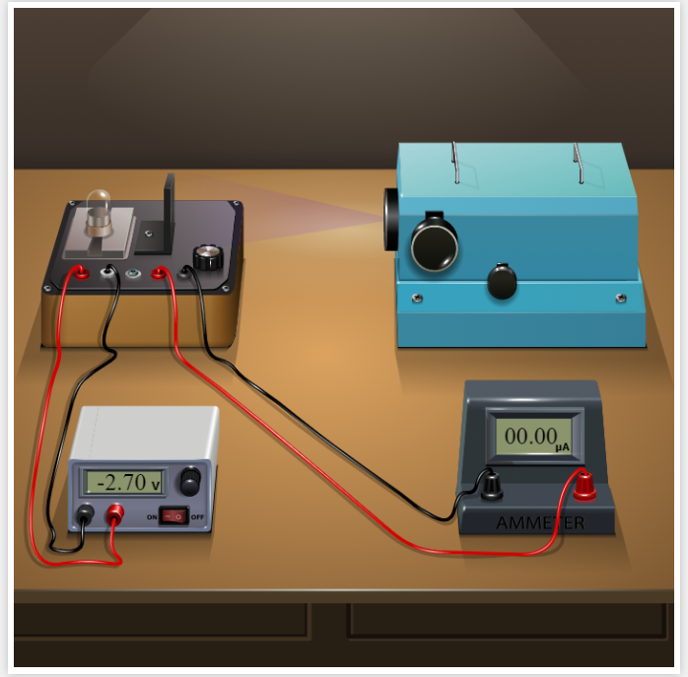
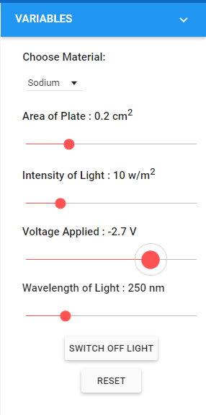
Then gradually decrease the voltage (to negative value ) so that the photo current becomes zero. This is the stopping potential. Find it for at least five different wavelengths (below threshold wavelength) of the incident light.

Slide 23
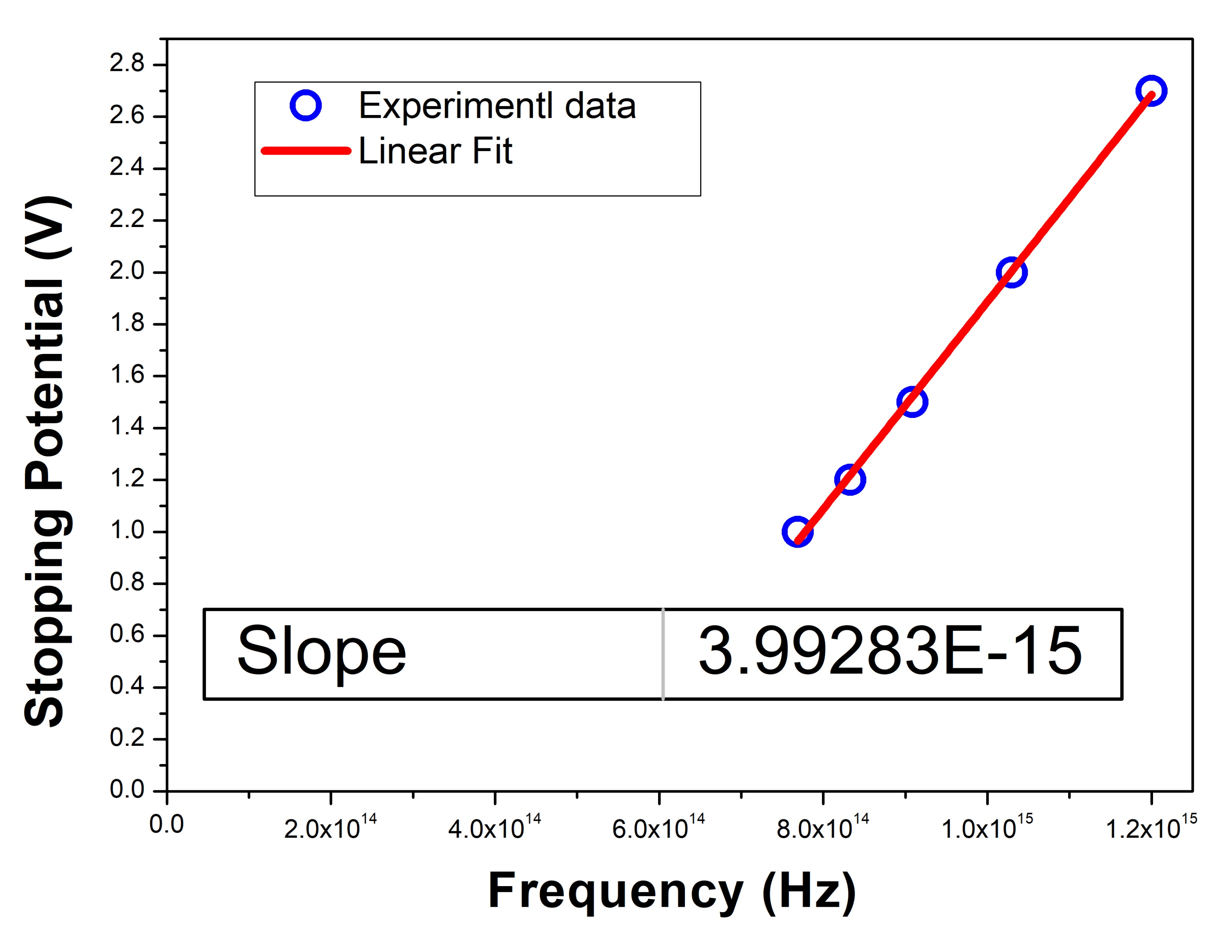
Worksheet and Calculation
Serial number | Wavelength of light (nm) | Frequency (Hz) ν =c/λ | Stopping potential (V)
1 | 250 | 1.20 × 10¹⁵ | -2.7
2 | 290 | 1.03 × 10¹⁵ | -2.0
3 | 330 | 9.09 ×10¹⁴ | -1.5
4 | 360 | 8.33 ×10¹⁴ | -1.2
5 | 390 | 7.69 ×10¹⁴ | -1.0
Data not to share with students
Calculated value of Planck’s Constant = e × slope= 6.4 ×10⁻³⁴ J-s
Work function = hʋ_{o} (in eV) where ʋ_{o} is the threshold frequency (intercept on X-axis)
Dr. Subhojyoti Sinha

Slide 24
Activity Based Questions while the students perform the experiment in virtual lab

Slide 25
Activity based question
A
A2.1 Consider the case when you perform the experiment with Sodium as cathode material and have fixed intensity, wavelength of the incident light. In the simulator how does the photocurrent varies with the change in cathode ( illuminated) plate area (no retarding voltage applied)?
Photocurrent increases with increase in plate area
Photocurrent decreases with increase in plate area
Photocurrent remains same independent of plate area
No such option to change plate area is available with the simulator

Slide 26
Activity based question
A
A2.2 In this simulator, consider light of wavelength 300 nm is incident on the cathode material. There is no retarded potential applied to the cathode. Then which of the following is true
Photocurrent flows in the circuit if we choose Copper as the cathode material
because the incident wavelength is below the required threshold wavelength.
(B) Photocurrent flows in the circuit if we choose Sodium as the cathode material because the incident wavelength is below the required threshold wavelength.
(C) Photocurrent flows in the circuit if we choose zinc as cathode material because the incident wavelength is below the required threshold wavelength.
(D) There will be no current in the irrespective of the cathode material because the incident wavelength is always below the required threshold wavelength.

Slide 27
Activity based question
A
A 2.3 With this simulator, the maximum negative voltage that we can apply to the cathode
-5V
-10 V
-100 V
depends on which material we choose as cathode

Slide 28
Activity based question
A
A 2.4 Select plate area as 0.2 cm², intensity of light 30 W/m², wavelength of incident light equal to 250 nm in the simulator. The stopping potential
is independent of intensity of incident light
decreases with decrease in intensity of the incident light
decreases with increase in intensity of the incident light
The given variables can not be selected in the simulator

Slide 29
Activity based question
A
A 2.5 Consider light of wavelength 360 nm is incident on the cathode material. The frequency of the incident light is
1.20× 10¹⁵ MHz
83.3 THz
1.20× 10¹⁵ kHz
8.33× 10¹⁴ Hz

